Slide 1
2023 State Update
Leroy Wade
Deputy Commissioner
Missouri Department of Higher Education and Workforce Development

Slide 2
Agenda
DHEWD Update
Budget Update
Legislative Session
State Aid Update
Outreach/FAFSA Initiatives
Q&A

Slide 3

DHEWD Update

Slide 4
DHEWD Direction
Vision
  Every Missourian empowered with the skills and education needed for success
Mission
  To put Missourians on a path to learn, work, and prosper
Principles that guide our work
  People-focused, workforce-aligned, equity-centered, impact-driven
Values that define the way we work together
  Teamwork, collaboration, accountability, work-life balance

Slide 5
DHEWD Organizational Structure
State Workforce Development Board
Coordinating Board for Higher Education
Bennet Boggs
Commissioner
Vacant
Chief of Staff
Darian Jones
Executive Assistant &
Board Secretary
Taylee Soukup
External Relations
OPERATIONS
Leroy Wade
Deputy Commissioner
WORKFORCE DEVELOPMENT
Julie Carter
Director
POSTSECONDARY POLICY
Samantha Dickey
Interim Asst. Commissioner
PERFORMANCE & STRATEGY
Veronica Gielazauskas
Asst. Commissioner
COMMS. & OUTREACH
Heather Dolce
Asst. Commissioner
LEGAL
Kristin Stokely
General Counsel

Slide 6
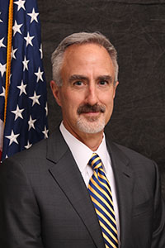
Meet the Commissioner
Dr. Bennett Boggs
Became Missouri Commissioner of Higher Education – April 2023
North Carolina Native
Higher Education Background
  Colorado Department of Higher Education
  National Council of State Legislatures
  Kentucky Education Professional Standards Board
  Kentucky Council on Postsecondary Education
  Kentucky General Assembly
  Public and Private Higher Education Institutions

Slide 7
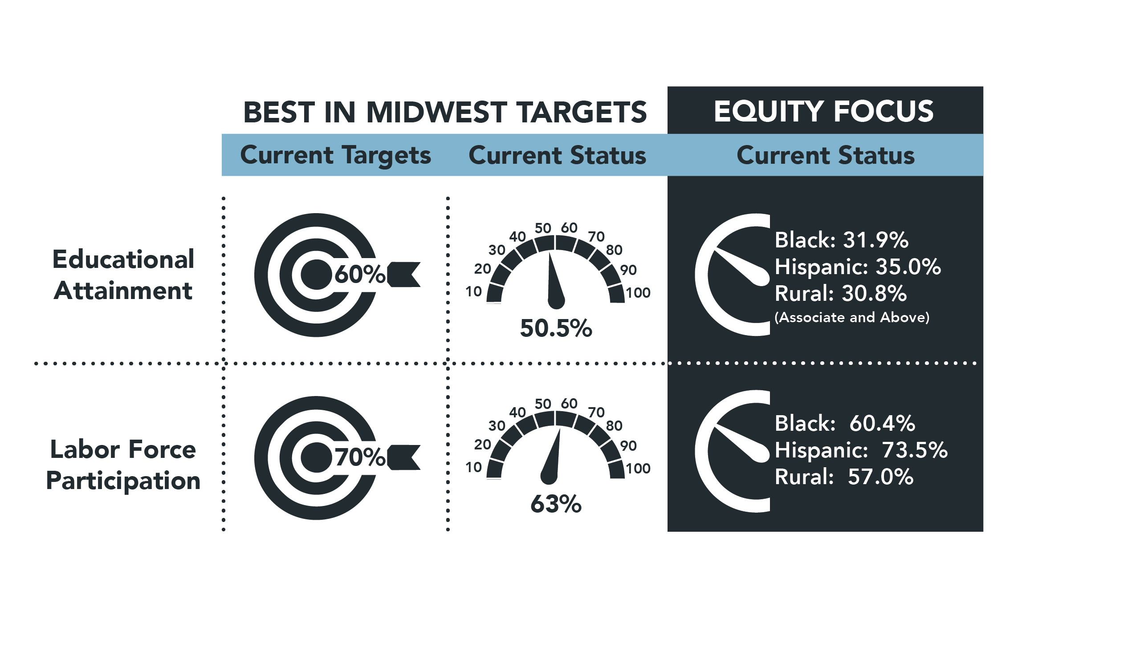
Building Missouri’ Future
A strategic plan to provide pathways and reduce barriers to educational attainment and workforce participation.

Slide 8
Other DHEWD Updates
Higher Education Funding/Efficiency Study
  Required by HB 3003 (2022)
  Study conducted by National Center for Higher Education Management Systems (NCHEMS)
  Final reports available at - https://dhewd.mo.gov/about/legislative/HigherEducationFundingStudy.php
  Proposes cost-based core funding model with recognition of mission, program mix, and student characteristics
  Proposed performance funding component includes six performance measures

Slide 9
Other DHEWD Updates
Adult Learner Network
Vision
  Create a common definition and language around adult learners
  Understand adult learners and their needs
  Create and utilize the Adult Learner Network
  Innovate/change the educational model
40+ Partners
  State agencies
  Postsecondary institutions
  Chamber of Commerce
  Other interested organizations

Slide 10
State Financial Aid Staff
Erik Anderson – Director of Financial Aid
Amy Haller – Senior Associate (Operations)
  Sarah Schedler
  Madalyn Barnhouse
  Brionna Sales
  Connie Bestgen (part-time)
Day Day – Senior Associate (Compliance)
  Amy Hedrick
  Jeffrey Ehimuh

Slide 11

Budget Update

Slide 12
FY 2024 General Revenue Estimate - $13.2B

Slide 13
FY 2024 Projected Operating Budget
$50.5B Projected – All Funds
$14.1B – General Revenue
Discretionary GR - $3.9B
  Higher Education – 28.9%
  MODOT – 23.9%
  DESE – 15.7%

Slide 14
FY 2024 and 2025 Budget Outlook
FY 2023 General Revenue Collections
  Increased by 2.7% over 2022
  FY 2022 increased by 14.6% over 2021
FY 2024 GR Revenue Estimate (consensus) was 0.7% growth
  GR collection through September – 4.2% decline (YoY)
  GR collection through September – 2.9% decline (YTD)
FY 2025 GR Outlook
  Wage growth and consumption will moderate
  Domestic and international concerns pose key risks to outlook
  Unclear impact of recent federal and state tax changes

Slide 15
FY 2025 DHEWD Requests for New Funding
FY 2024 Supplemental
  $5M – DHEWD Transfer Authority
  $100K – Missouri State University Debt Offset
  $ 25K – Southeast Missouri State University Debt Offset
  $2.2M – Lincoln University Land Grant Match

Slide 16
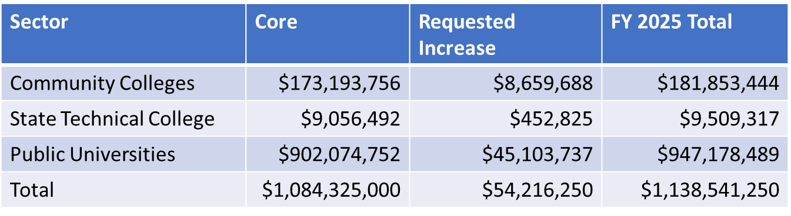
FY 2025 DHEWD Requests for New Funding
Institutional Funding ($104.6M)
Core Inflationary Increase ($54.2M)
  Across the board 5% increase
MoExcels ($49.4M placeholder)
Returning Heroes ($1.0M)

Slide 17
FY 2025 DHEWD Requests for New Funding
Internal DHEWD Requests
$1.8M to convert to Indirect Cost Rate
$67,000 Proprietary Certification Spending Authority Increase
$3M for Apprenticeship Missouri
$1M for Workforce Outreach
State Financial Aid Programs
No increases requested for major programs
Possible increase for War Veterans program ($170,000)

Slide 18
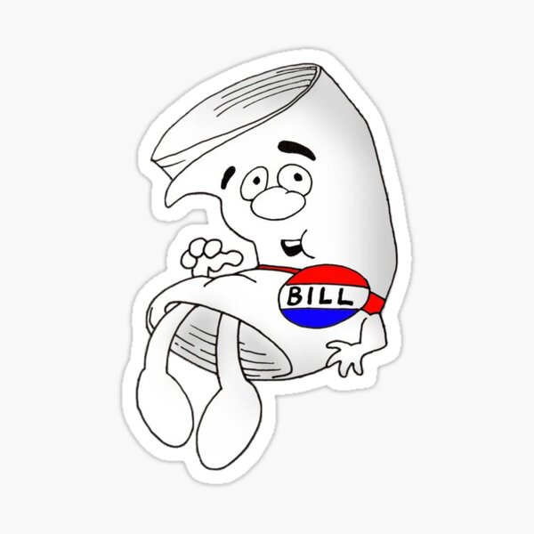
Legislative Review

Slide 19
First Regular Session of the 102nd General Assembly
Dates and Numbers
Session began: Wednesday, January 4
Session ended: Friday, May 12
Number of bills filed: 2,201
Number of bills TAFP (including budget): 58
Number of TAFP bills impacting DHEWD: 4

Slide 20
SB 39 (Sen. Thompson-Rehder)
Limits athletic competitions to students whose biological sex aligns with the designated gender of the event.
Some exceptions for female students
SB 75 (Sen. Black)
Closes IHE records regarding investments in or financial transactions with business entities for investment purposes.

Slide 21
HB 417 (Rep. Henderson)
Creates incentives to encourage individuals to obtain employment related skills
State agencies cannot use postsecondary degree as job requirement, with some exceptions
NIL amendment
Establishes grants to employers for upskilling employees
Tax credits for employers who hire interns or apprentices

Slide 22
2024 Session Potential Legislation
Career-Tech Certificate Program/A+ Expansion
  HB 76 (2023)
  Cover tuition, books and fees for eligible programs
  Non-graduate level certificate or other industry-recognized credential below the graduate level
  Limited to A+ eligible institutions plus WGU
Access Missouri/Bright Flight award increases/other changes
Higher education funding formula/performance funding
DEI

Slide 23
2024 Legislative Session Calendar
January 5 – Session Begins
Late January – State of the State and Executive Budget Released
February – Budget Hearings Begin in House
Mid-March – Legislative Spring Break
March – House Floor Action on Budget
April – Budget Process Moves to Senate
May 3 – Final Legislative Action on Budget
May 10 – Session Ends
September 11 – Veto Session

Slide 24
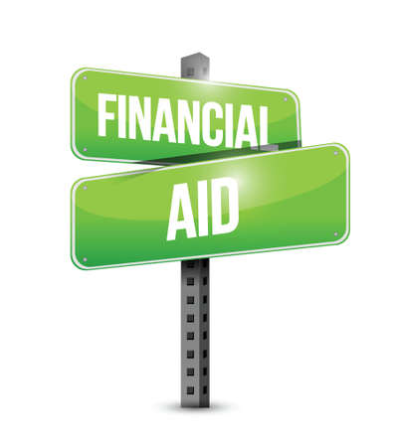
State Aid Update

Slide 25
Bright Flight
FY 2023 – 8,623 recipients/$21.1M dibursed
FY 2024 -8,000 projected recipients, $27.6M appropriated
FY 2025 Request - $27.6M total request (no increase)
  Anticipate a modest decline in recipients
    Ongoing score change adjustment
    Increasing number of awards to top fourth and fifth percentile

Slide 26
Access Missouri
FY 2023 – 35,717 recipients/$72,752,297 disbursed
FY 2024
  $75.4 appropriated (+$5M gaming)
  Projecting 44,500 recipients – April 1 deadline
  Awards at 100% of statutory maximum - $20,000 EFC cutoff
FY 2025 request
  No increase
  Unclear impact of new FAFSA/delayed FAFSA release

Slide 27
A+
FY 2023
  13,939 recipients/$52.3M disbursed
  Average award - $3,750
FY 2024
  14,300 projected recipients/$61.9M appropriated
  Average award - $4,050
FY 2025 Request
  No increase
  14,450 projected recipients; $4,300 average award

Slide 28
Fast Track
FY 2023
  658 recipients/$2.2M disbursed
  Average award - $3,377
FY 2024
  $4.7M appropriated
  1,105 projected recipients
FY 2025 Request
  No increase
  1,330 projected recipients

Slide 29
Dual Credit/Dual Enrollment
New Program for FY 2023
  596 recipients/$448,316
  Average award - $752
FY 2024
  835 projected recipients/$7M appropriated
FY 2025 request
  No increase
  870 projected recipients

Slide 30
Other Programs
Public Safety Officer Survivor
Wartime Veterans Survivor
Kids’ Chance
AP Incentive Grant
Minority and Underrepresented Environmental Literacy

Slide 31

DHEWD Outreach

Slide 32
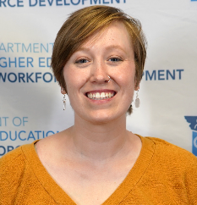
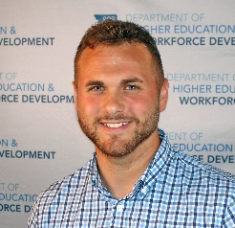
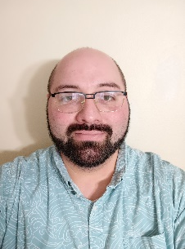
Meet the New Outreach Team Members
Alison Notter, Outreach Services Coordinator, Central Region
Cade Tremain, Outreach Services Coordinator, Southwest Region
Gary W. Standiford, FAFSA Outreach Coordinator

Slide 33
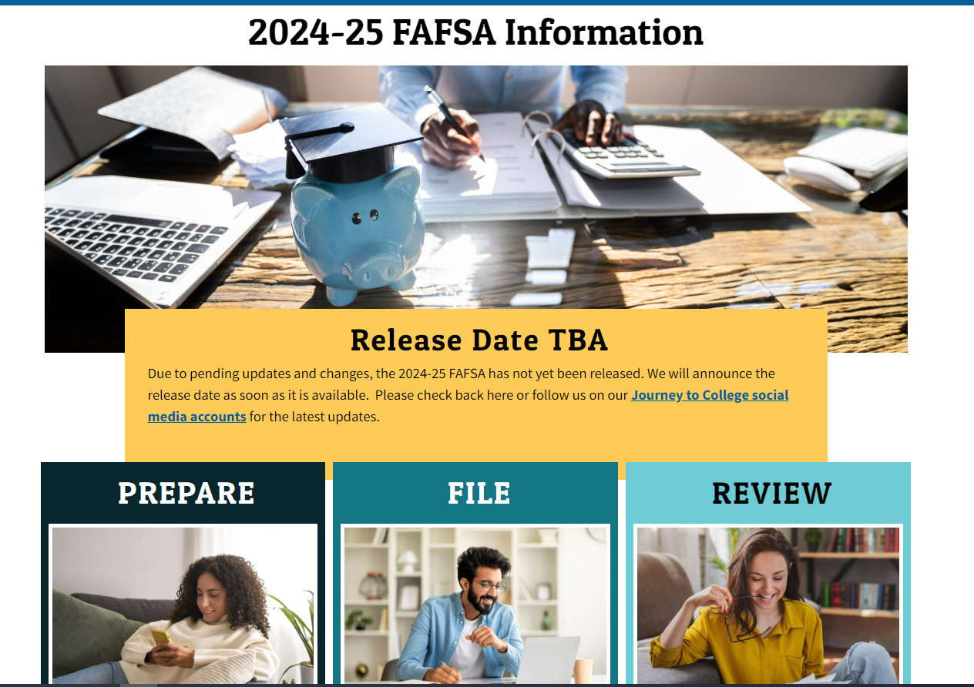
New FAFSA Info
https://journeytocollege.mo.gov/fafsa-info/
FAQ’s
Resources
Infographics
Social Media kits

Slide 34
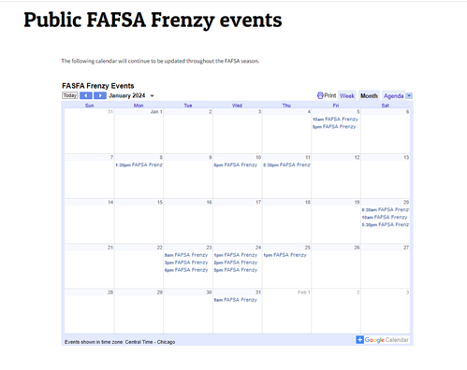
FAFSA Frenzy events are now in an easy to use calendar format.
Volunteers needed!

Slide 35

Questions?

Slide 36
Leroy Wade
Deputy Commissioner – DHEWD
Leroy.wade@dhewd.mo.gov

